Slide 1
NLP Based Question Answering Model on SQuAD Dataset
- Rahul Raghava Peela

Slide 2
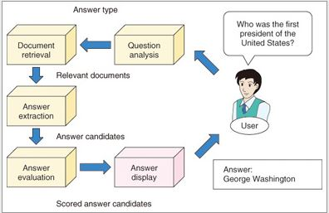
INTRODUCTION:
This project presents a question-answering model based on natural language processing (NLP) techniques.
Majorly, trained and evaluated on the Stanford Question Answering Dataset (SQuAD).
Most importantly, assert BERT model’s dominance in the domain of question and answering learning problems.

Slide 3
SQuAD
SQuAD, or the Stanford Question Answering Dataset is a widely used dataset for training and evaluating natural language processing (NLP) models.
The SQuAD dataset is a widely-used benchmark for evaluating the performance of NLP-based question-answering systems.

Slide 4
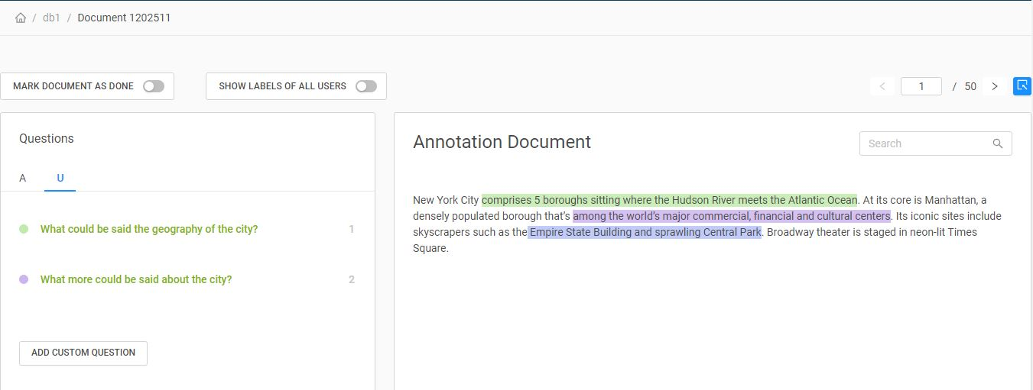
Dataset Creation

Slide 5
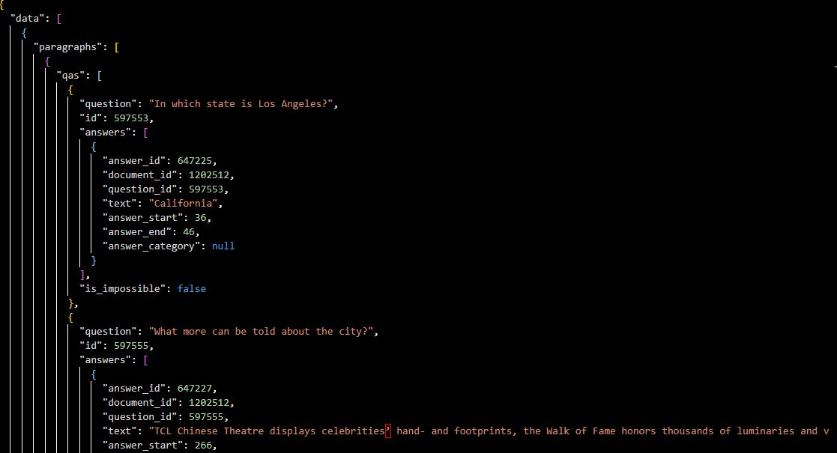
Our Custom Dataset

Slide 6
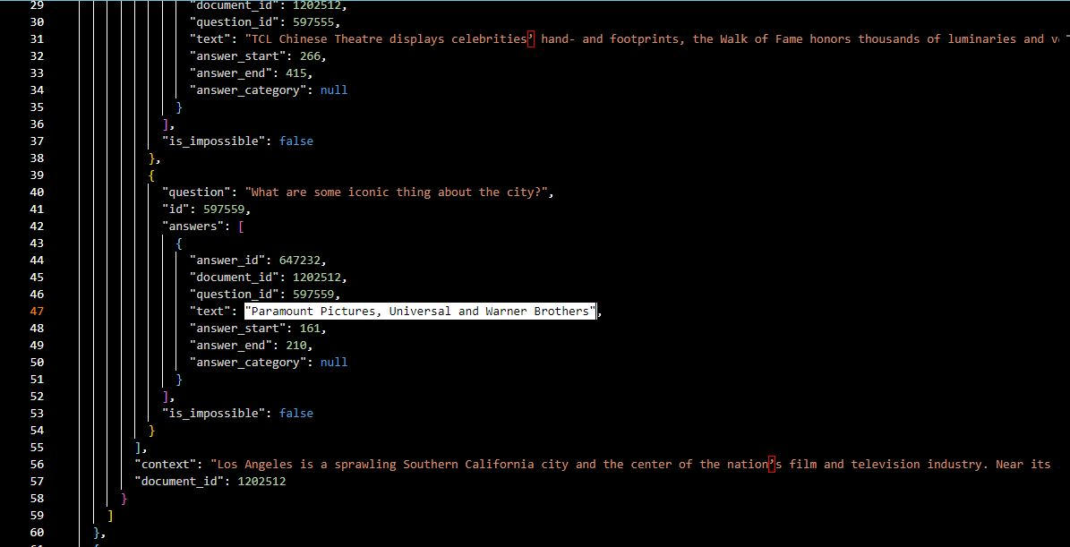

Slide 7
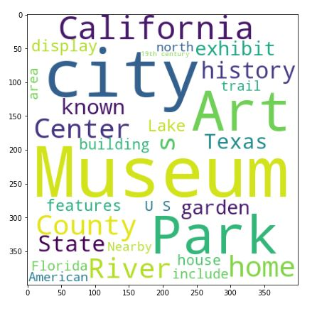
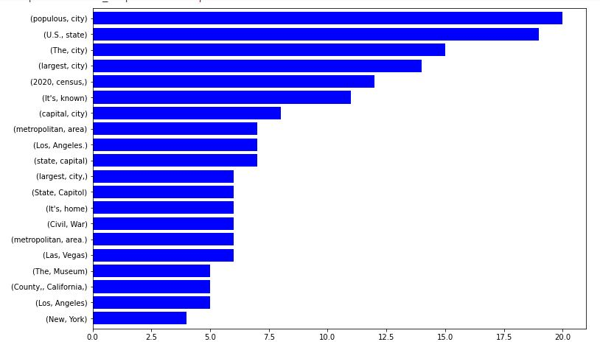
Visualisation

Slide 8
Models
Bert Base Uncased.
Bert Large Uncased Masked Model.
DistilBERT base uncased.

Slide 9
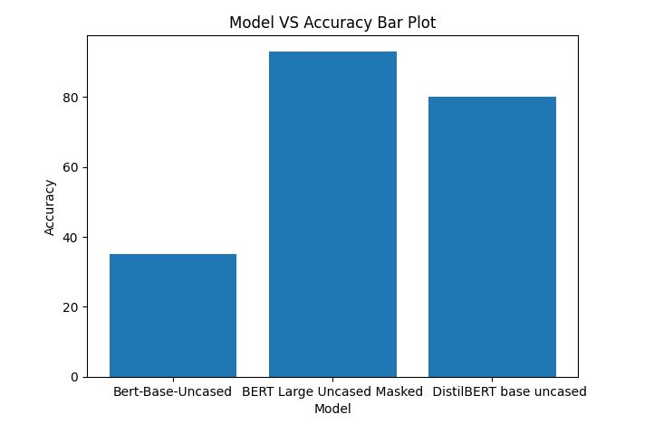
Comparison
BERT Large Model offered highest accuracy at 87.6% due to its pretrained weights and larger context.
Next up was DistilBERT, which is a powerful contender at 82.4% accuracy.
Lastly, BERT Base model offered modest 36% accuracy, showing the need for fine-tuning.

Slide 10
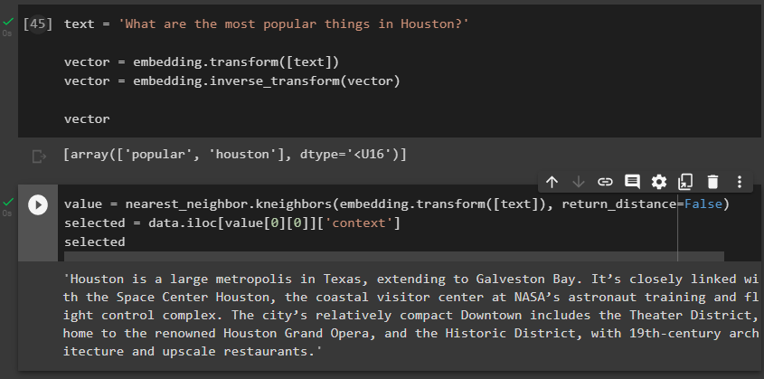
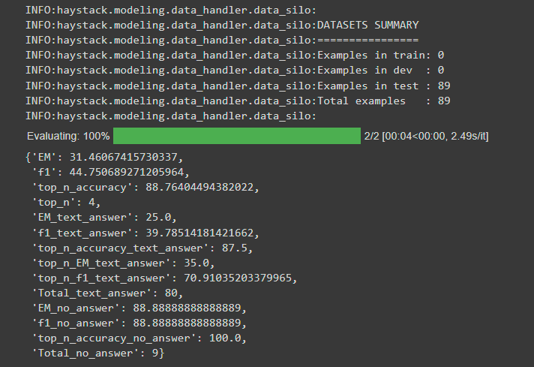
Example Analysis
What are the insights we can learn from the dataset?
Relationship between a question and a document.
Embeddings
Word Embeddings from Question Text
How do you know if you actually learned?
We are able to predict the answer to an unknown question that was not part of our ground truth i.e training data.
BERT Large Model’s Prediction for Isolated Validation Dataset

Slide 11
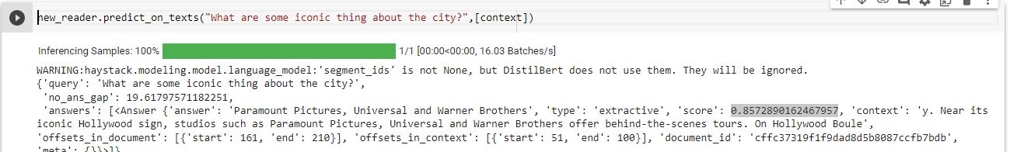
Example Analysis - Model Output
What’s a typical question for this Context?
What are some iconic things about the city?
Paramount Pictures, Universal and Warner Brothers is the answer as per our model with a score of 85.7%

Slide 12
Future Work
Build a larger dataset for all the cities in USA along with expanded annotations for various questions.
Build a question-answer modeling pipeline that generates new questions and answers automatically using user data.
Explore additional fine tuning techniques in BERT to attain higher accuracy for a larger dataset.
Explore linear modeling further and improve accuracy.

Slide 13
Conclusion
In conclusion, the NLP-based question-answering model on the SQuAD dataset shows promising results and demonstrates the potential for natural language processing techniques to accurately answer questions based on a given context.
All the 3 models we utilized exhibited performance on the SQuAD dataset indicates that it is able to effectively understand the intent behind a question and retrieve the appropriate information from the provided context.
Further research and development in this area has the potential to improve the model's performance and expand its capabilities, leading to more effective and efficient question-answering systems.

